Slide 1

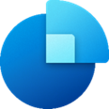








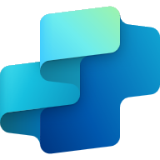




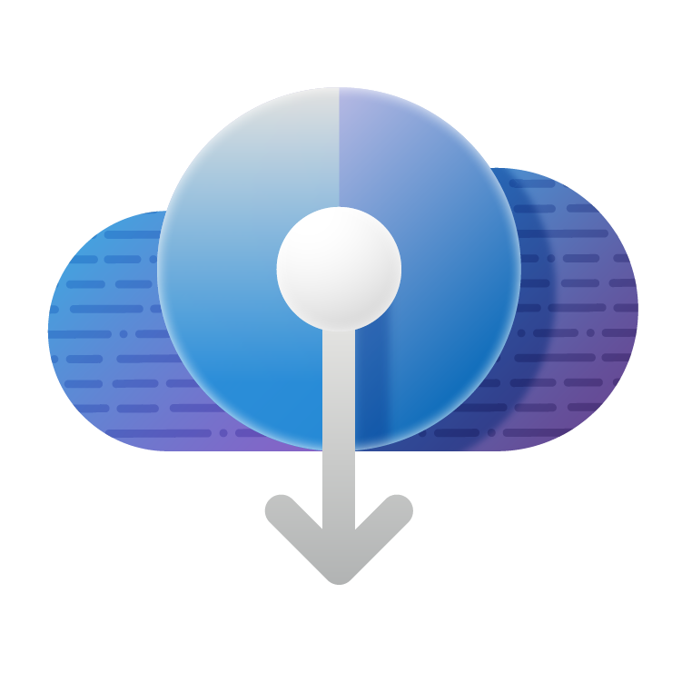
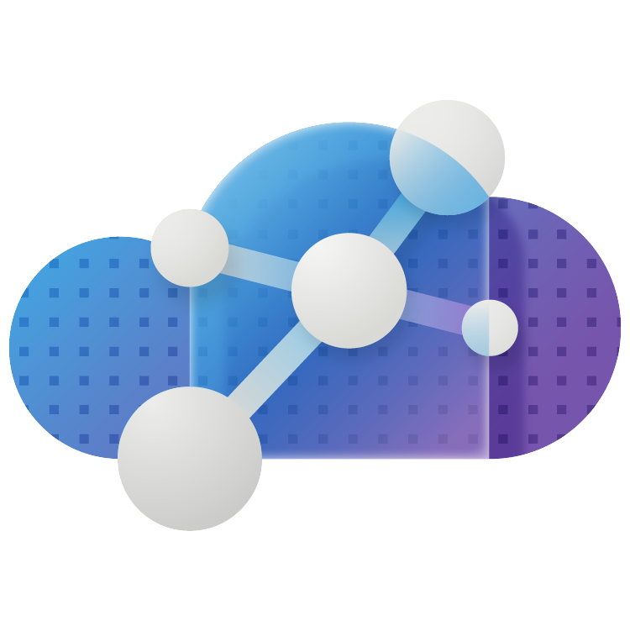
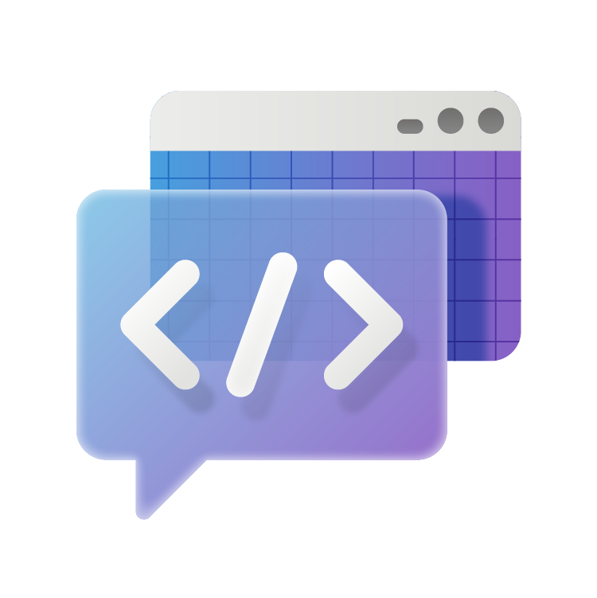

Enterprise AI Platform
3
Dynamics 365
Animation Slide 1 of 2 Option B (no grey box for dynamics which appears on following slide box for dynamics)
Sales
Customer Insights
Customer Service
Field Service
Finance
Supply Chain Management
1
1
Power Platform
Power
Apps
Power
Automate
Copilot
Studio
Power
Pages
Power
BI
Dataverse
Azure
Infrastructure
Digital & App Innovation
Security
Operational databases | Analytics | Data governance
Data & AI
Notes:
D365 is a modular set of components that can be deployed independently tor quick ROI or as a complete solution as part of a transformation
CCAS is not new. Based off Customer Service and ACS, core component of Microsoft teams 320M monthly active uses 20X since 2019 (as of July 2024)
D365 is based on PP, you can think of this as a first part PP applications. PP is Low code AND Pro code
PP 1B new applications built by 2028 (IDC 2024). more than all apps built in the last 40 years
And all of this is built on an enterprise grade secure platform: Azure

Slide 2
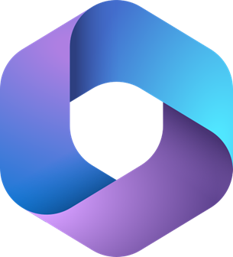
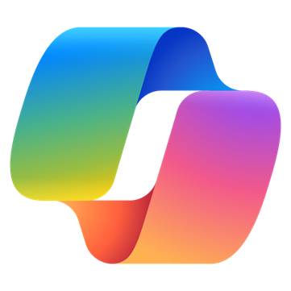

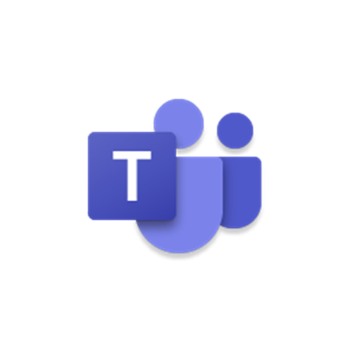

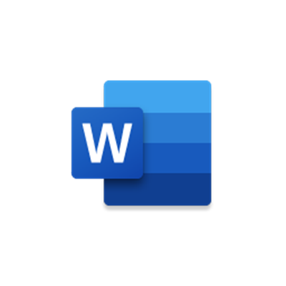

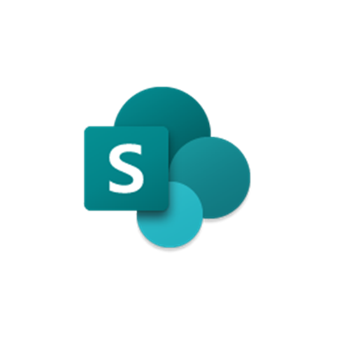





3
Enterprise AI Platform
3
3
3
Modern Work
Dynamics 365
Digital Contact Center Platform
Animation Slide 2 of 2
Copilot
Outlook
Teams
PowerPoint
Word
Excel
SharePoint
Sales
Customer Insights
Customer Service
Field Service
Finance
Supply Chain Management
Self Service
Assisted Service
Operations
1
2
1
Extensions
Power Platform
Power
Apps
Power
Automate
Copilot
Studio
Power
Pages
Power
BI
Dataverse
Azure
Infrastructure
Digital & App Innovation
Security
Operational databases | Analytics | Data governance
Data & AI
Notes:
D365 is a modular set of components that can be deployed independently tor quick ROI or as a complete solution as part of a transformation
CCAS is not new. Based off Customer Service and ACS, core component of Microsoft teams 320M monthly active uses 20X since 2019 (as of July 2024)
D365 is based on PP, you can think of this as a first part PP applications. PP is Low code AND Pro code
PP 1B new applications built by 2028 (IDC 2024). more than all apps built in the last 40 years
And all of this is built on an enterprise grade secure platform: Azure

Slide 3
















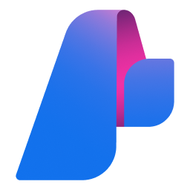






3
Enterprise AI Platform
3
3
3
Modern Work
Dynamics 365
Digital Contact Center Platform
Azure Services Reveal
Copilot
Outlook
Teams
PowerPoint
Word
Excel
SharePoint
Sales
Customer Insights
Customer Service
Field Service
Finance
Supply Chain Management
Self Service
Assisted Service
Operations
1
2
Extensions
1
Power Platform
Power
Apps
Power
Automate
Copilot
Studio
Power
Pages
Power
BI
Dataverse
Azure
Kubernetes
Service
App Service
Container Apps
Azure
Functions
Logic
Apps
API
Management
Azure
SQL
Cosmos
DB
Intune
Defender
Entra
Operational databases | Analytics | Data governance
Sentinel
Purview
Synapse
Analytics
Analysis
Services
Fabric
AI Foundry
Microsoft
Graph
Cognitive
Services
Bot
Services
Azure
Machine Learning
Azure
AI Search
Notes:
D365 is a modular set of components that can be deployed independently tor quick ROI or as a complete solution as part of a transformation
CCAS is not new. Based off Customer Service and ACS, core component of Microsoft teams 320M monthly active uses 20X since 2019 (as of July 2024)
D365 is based on PP, you can think of this as a first part PP applications. PP is Low code AND Pro code
PP 1B new applications built by 2028 (IDC 2024). more than all apps built in the last 40 years
And all of this is built on an enterprise grade secure platform: Azure

