Slide 1
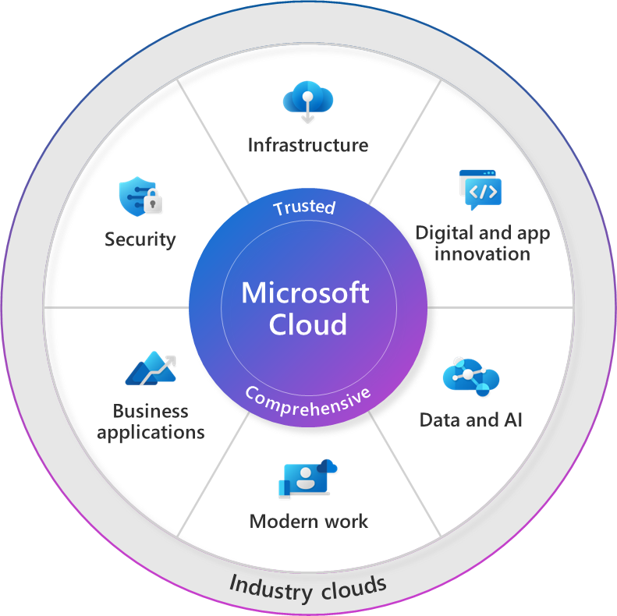







Culture
Technology
Our
Mission
Leadership principles
Manager expectations
Cultural
attributes
Customer obsession
Growth
mindset
Notes:
0:00:50
Cultural attributes >
Customer obsessed • Diverse & Inclusive • One Microsoft
Company values >
Respect • Integrity • Accountability
Manager expectations >
Model • Coach • Care
Leadership principles >
Create clarity • Generate energy • Deliver success
Do you know what your customers need?
Can you deliver it?
Faster than your competition?
If you can answer yes to all of these questions (then congratulations if it's no or we can do beter
not really then I'd love to meet each of the people in your business that cares about this so Microsoft can help you with a strategy (not just a solution) the title of this presentation is called getting to yes.
These questions are fundamental human behaviours : Listen, Respond and action.
To delivery these we can map our digital transformation story
1 understand engage your customers
2 action empower your employees
3 faster is optimise operations
Underppining these questions is culture and technology. Do you have the culture to delivery this and are you empowered by technology to deliver?
You could say these questions are routed in our vision f digital transformation
Engage
Transform
Optimise
wmpoeer

