Slide 1
FinDemo – A Core Financial Services Demonstration Solution Screenshots
Mark Margolis
Internal: http://aka.ms/crmtsp
External: http://aka.ms/mscrm

Slide 2
FinDemo – Overview of Scenarios
Coming Soon
Asset & Wealth Management
Investment & Corporate Banking
Insurance
Commercial Banking
Retail Banking
Broker Management

Slide 3
FinDemo – Overview Components
Dashboards
Features
Components
Account Plan Overview
Claims Dashboard
User Adoption Dashboards
Single Client View
Deals
Research
Project Management
Client Tree View
InsideView Social Insights
Client Insight & Client Value
Fund & Investor Holdings
Policies Dashboard
Funds & Investor Holdings
On Boarding
Trades
Supplier & RFP Management
XRMC Activity Timeline
SingleView360
Call Report
Multi Channel Interaction
Stock Ticker
Share of Wallet
Account Planning
Claims
User Adoption Scoring
Call Queue
On Boarding Overview & Detail
Itinerary Planning
Opportunity Analytics
Policies
Multi Channel Usage

Slide 4
Fund & Investor Holdings

Slide 5
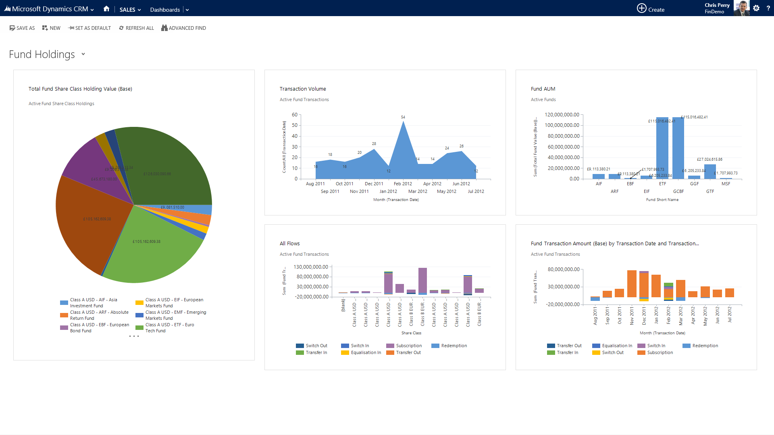

Slide 6
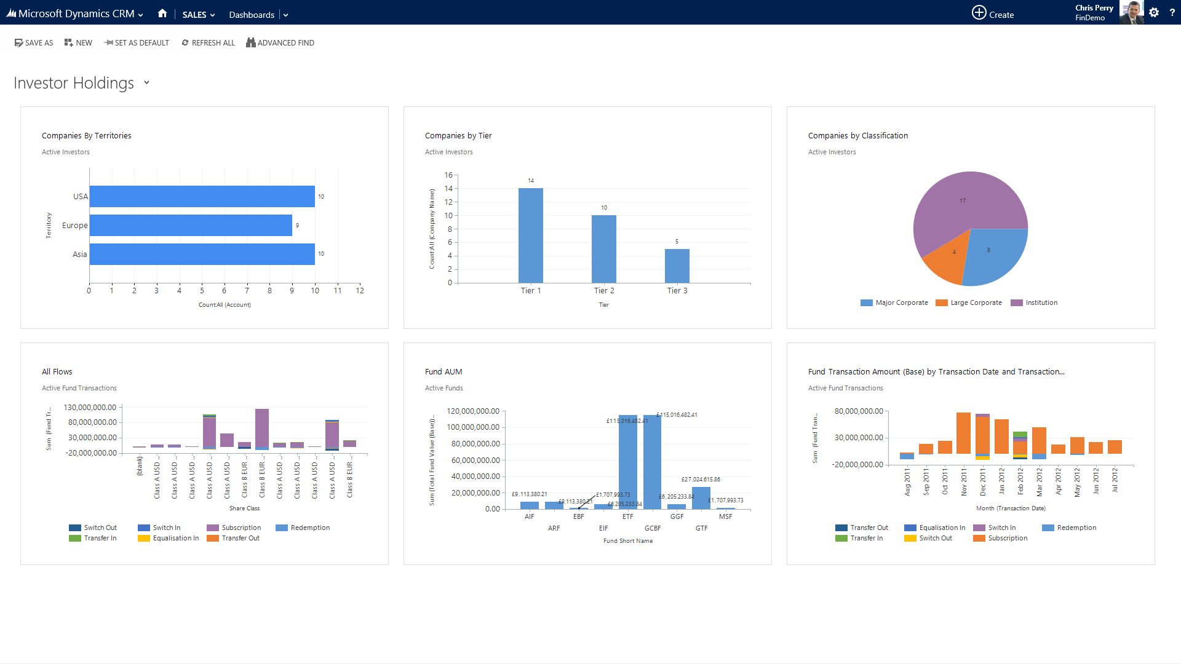

Slide 7
Single Client View & Investor Profile

Slide 8
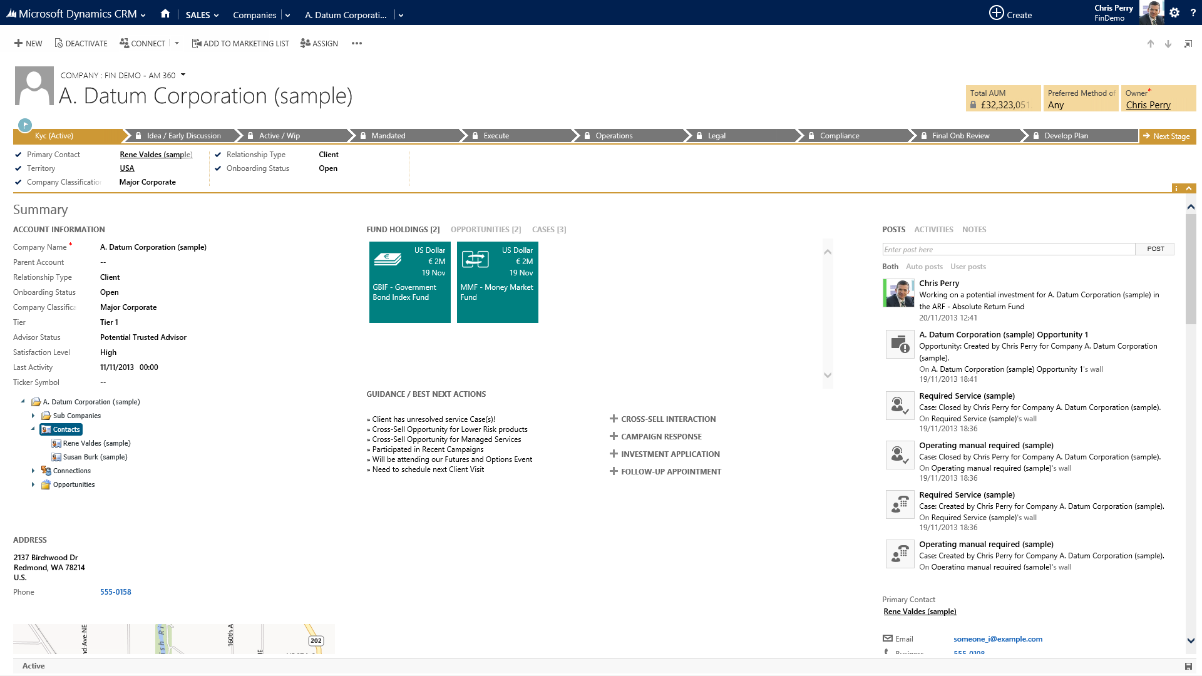

Slide 9
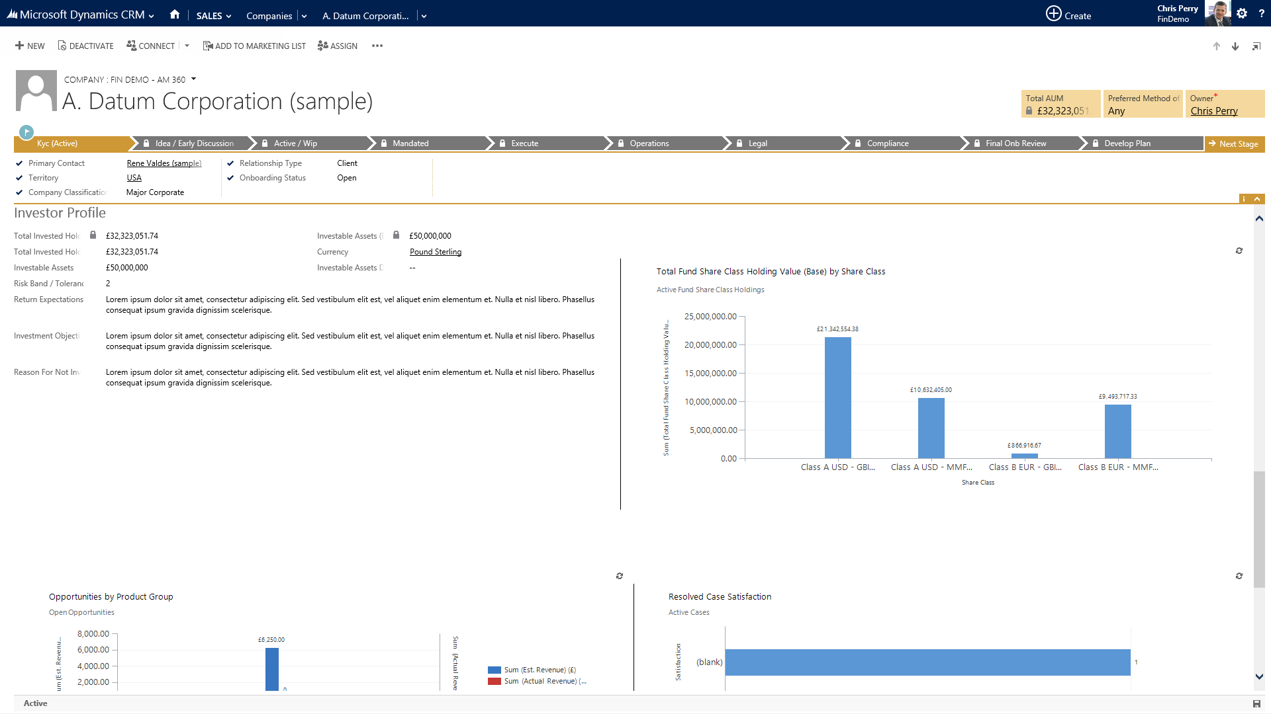

Slide 10
Client Insight & Client Lifetime Value

Slide 11
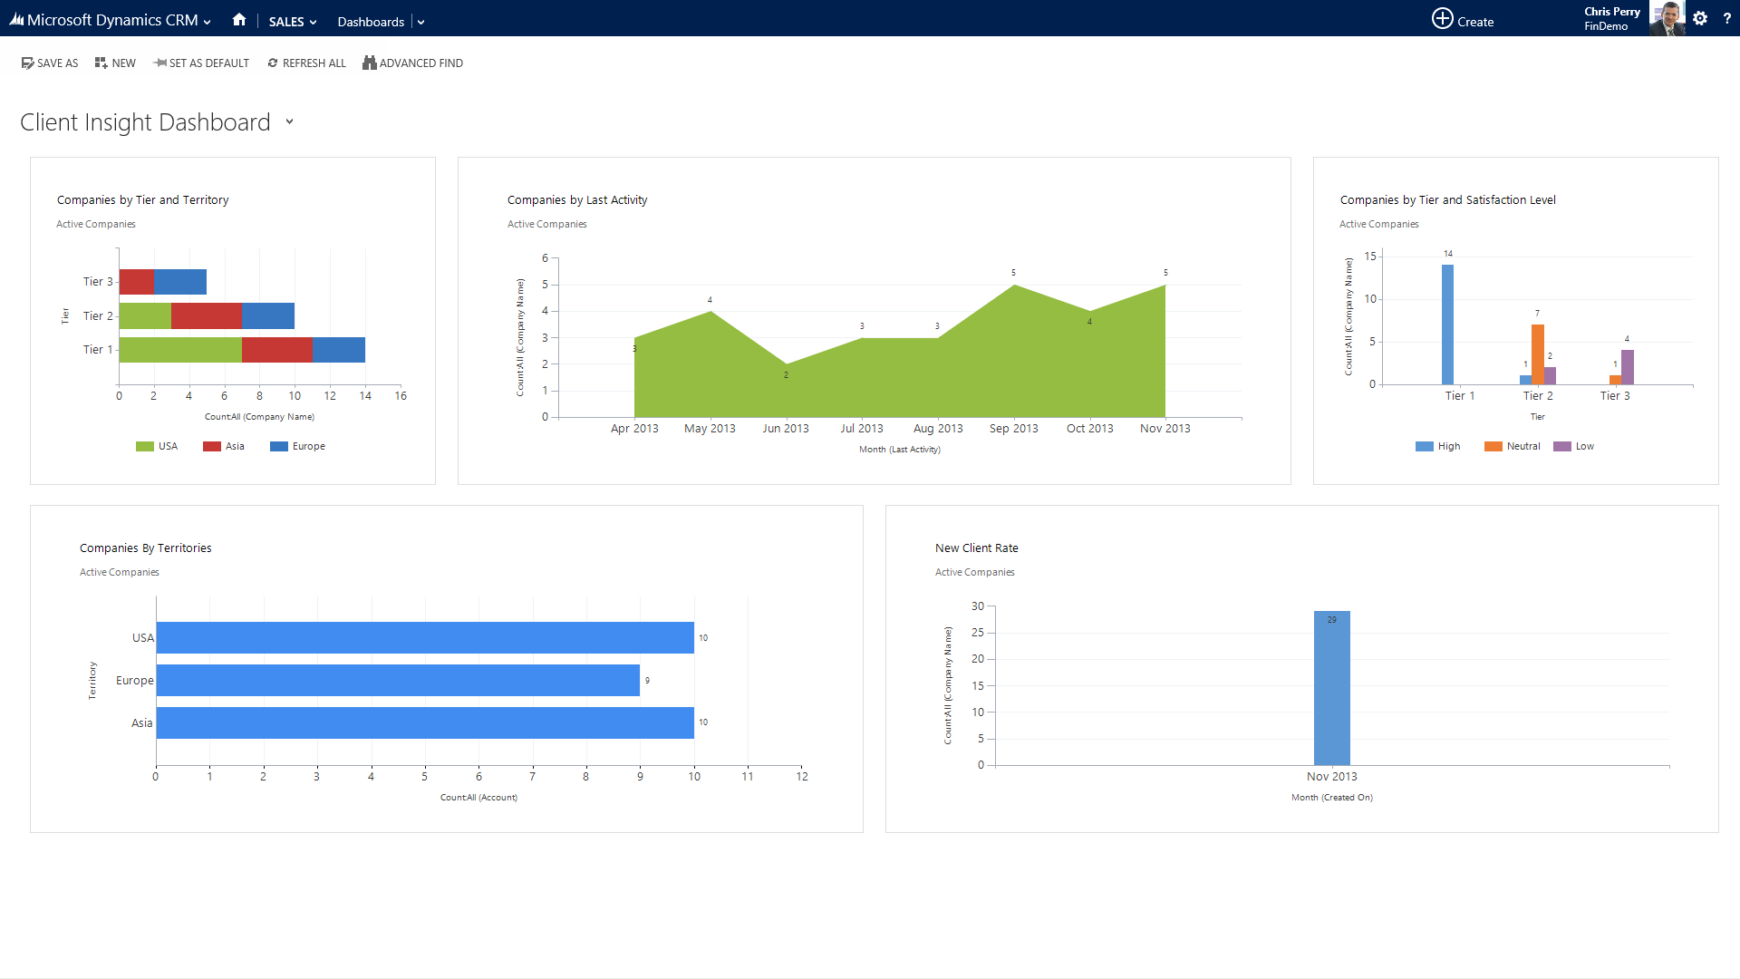

Slide 12
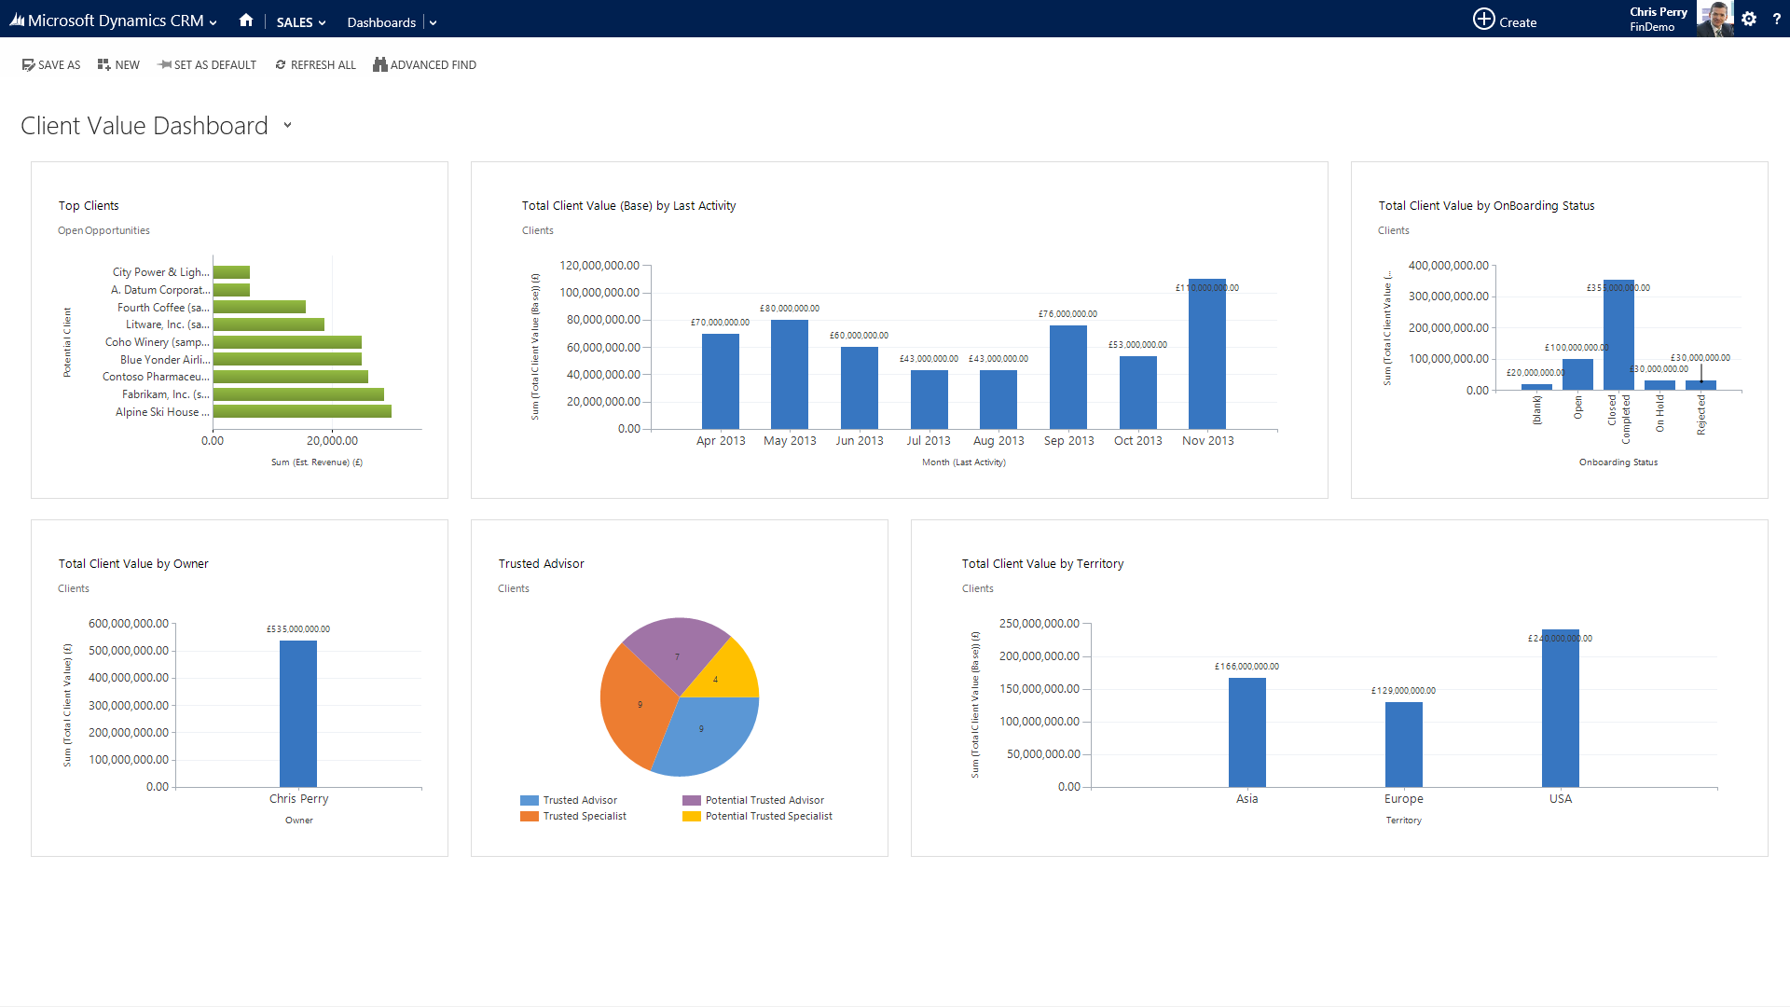

Slide 13
Onboarding

Slide 14
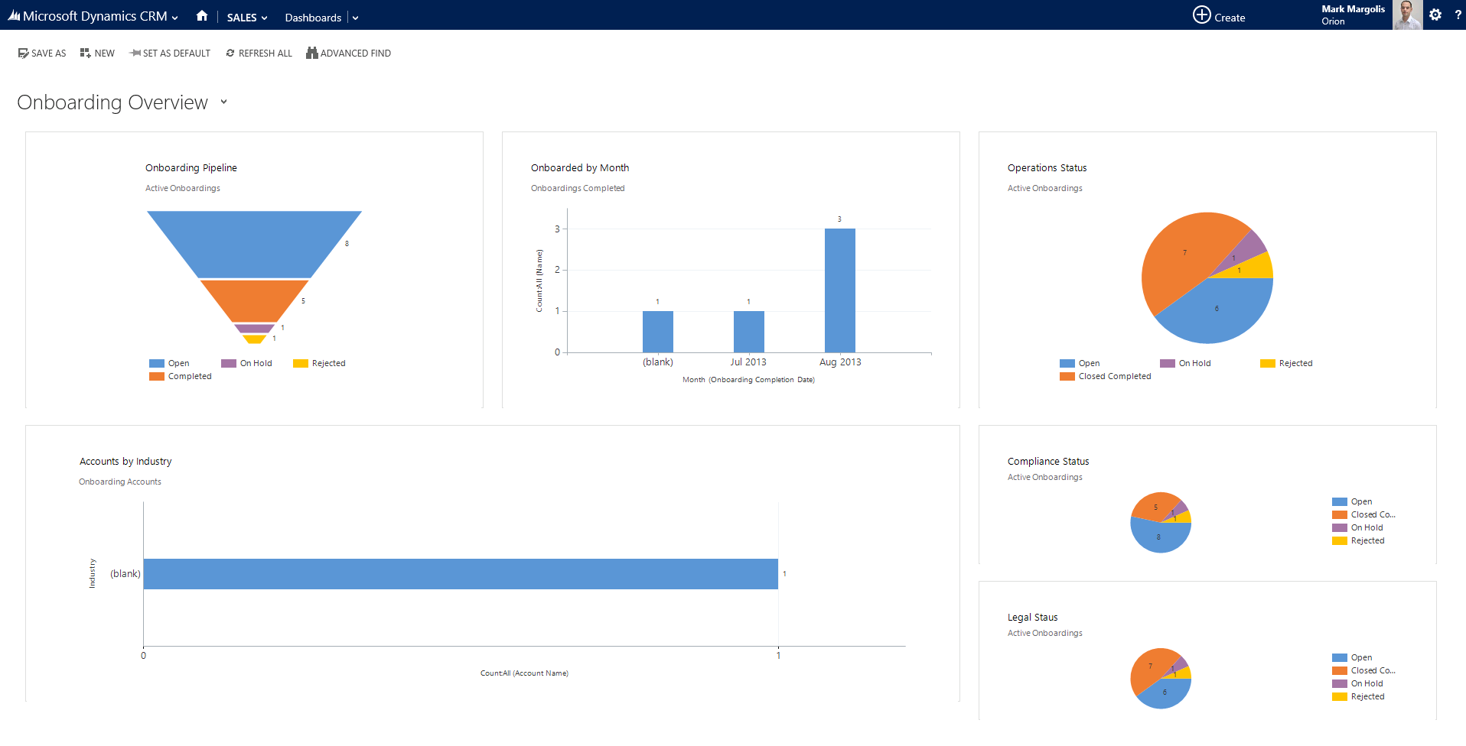

Slide 15
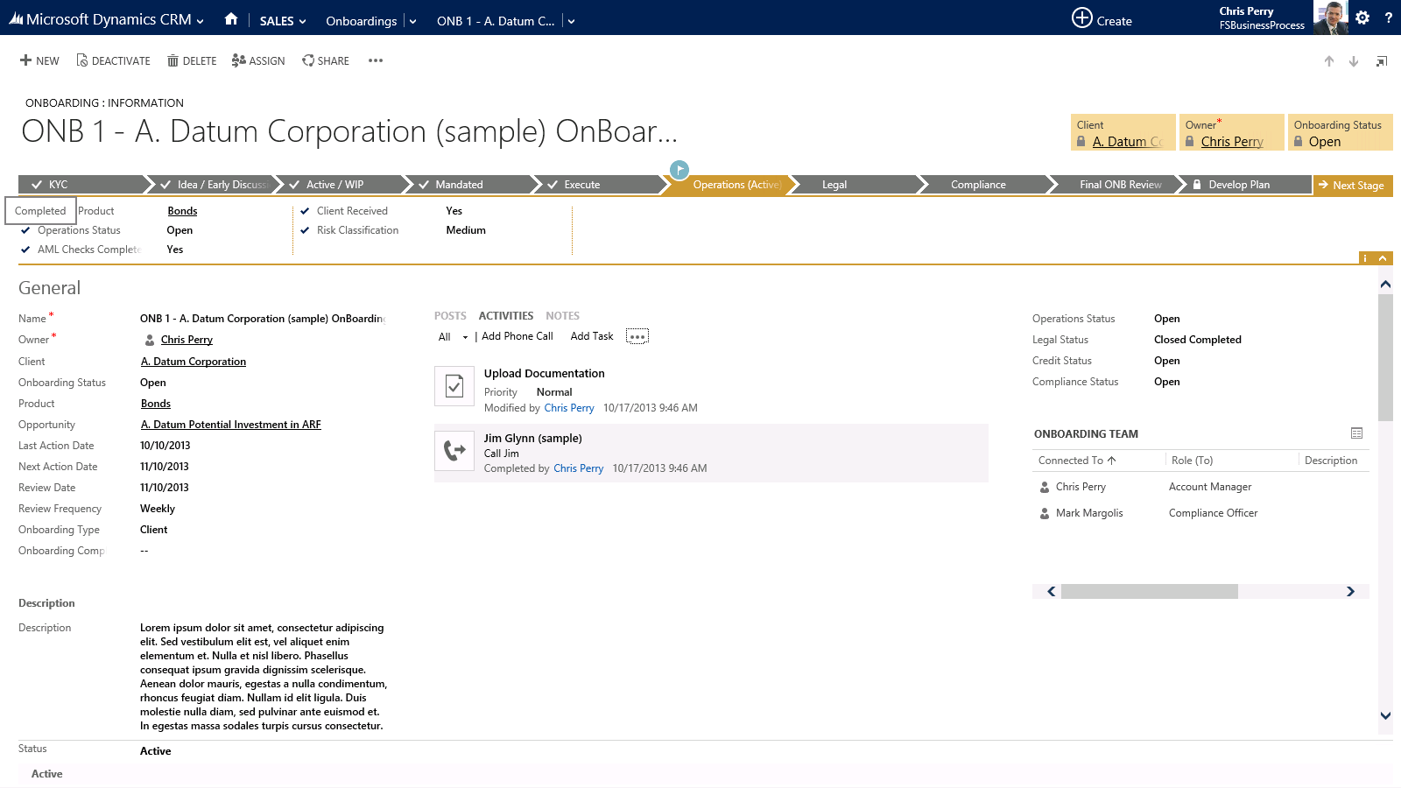

Slide 16
Account Planning

Slide 17
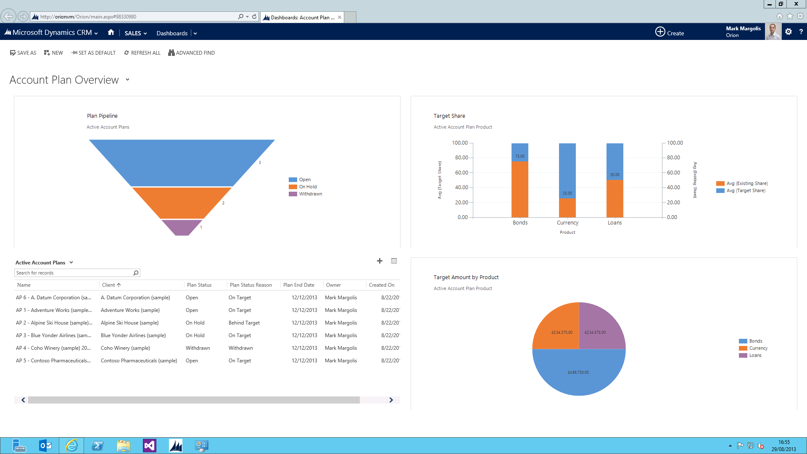

Slide 18
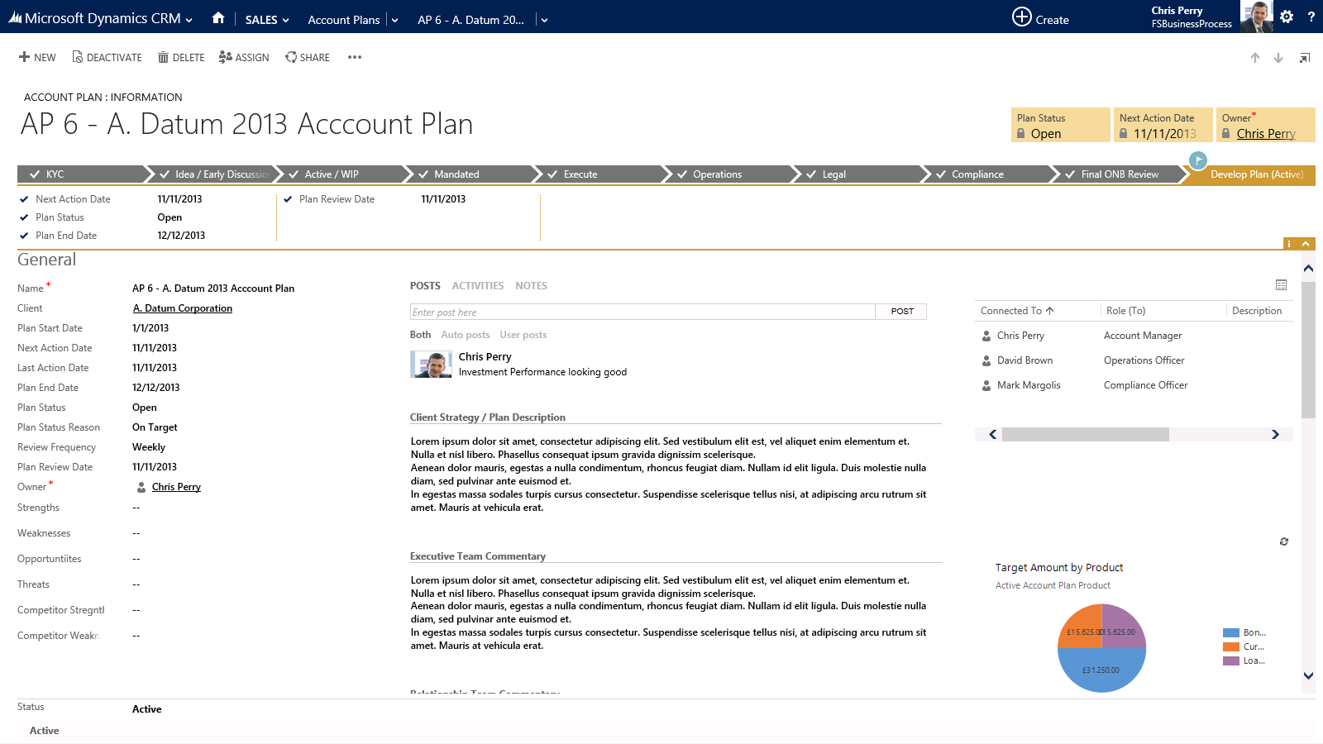

Slide 19
Multi Channel Interactions

Slide 20
